Slide 1
GEOG 4870/6870
Week 14: Spatial interpolation

Slide 2
Outline
Review: Tobler’s First Law & Spatial Autocorrelation
Introduction: What is Spatial Interpolation?

Slide 3
Tobler’s First Law & Spatial Autocorrelation
Tobler’s First Law of Geography
“Everything is related to everything else, but near things are more related than distant things” (Tobler, 1970)
Spatial Autocorrelation
Tests Tobler’s Law by assessing whether nearby features are more likely to share attributes than distant features.

Slide 4
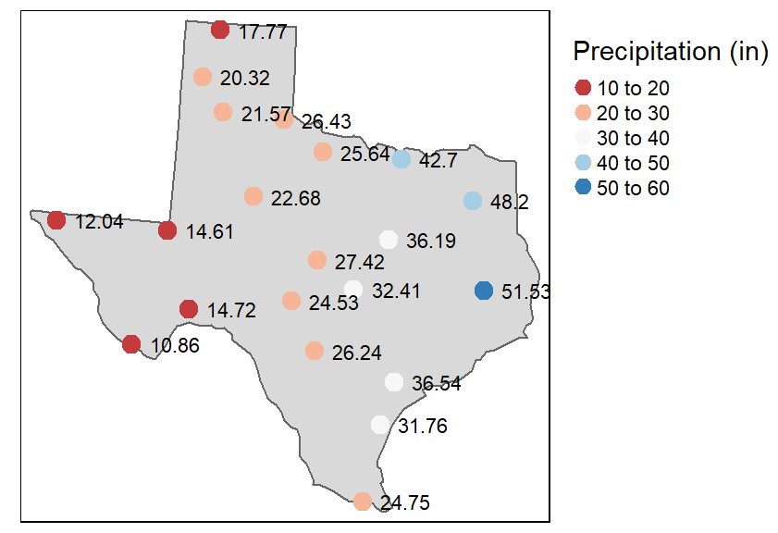
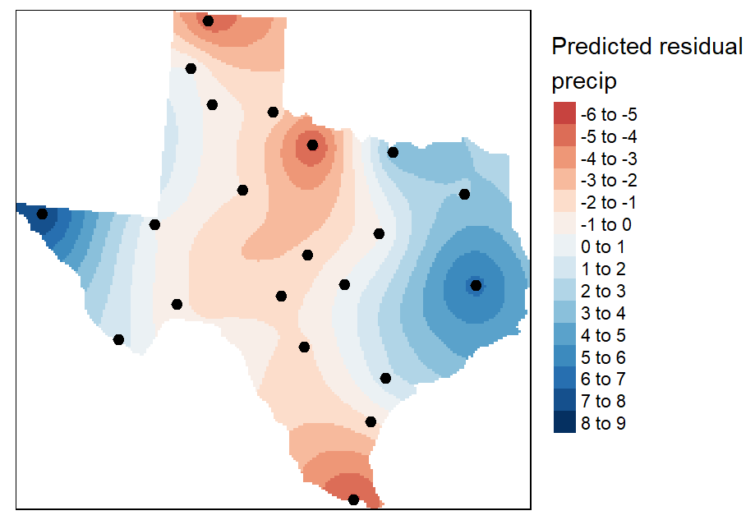
Tobler’s First Law & Spatial Autocorrelation
Spatial Interpolation relies on the assumptions made in Tobler’s Law, that spatial data exhibit some degree of spatial autocorrelation.
Fig 1. Ave. yearly precipitation (inches) for meteorological sites in Texas.
Fig 2. Krige interpolation of the detrended precipitation values.
Notes:
Our assumption that features exhibit spatial autocorrelation (the spatial dependency of geographic data; how similar are neighboring features to each other?), allows us to interpolate, or “predict” nearby unknown values based on nearby known values. We can interpolate ONLY because of the assumptions inherent in Tobler’s First Law: that nearby things are more similar than distant things.

Slide 5
What is Spatial Interpolation?
Spatial Interpolation is the prediction of a given phenomena (e.g., temperature, precipitation, elevation) in unmeasured locations, given observations in measured locations.
Can you think of cases where we might want to interpolate data?
e.g., temperature/precipitation, soil pH, lead concentrations, etc. data sampled at locations
WE TYPICALLY USE SPATIAL INTERPOLATION TO CREATE SMOOTH SURFACES OF
CONTINUOUS PHENOMENA FROM SAMPLED POINTS OF THAT PHENOMENA!

Slide 6
How does Interpolation differ from Point Pattern Analysis & Spatial Autocorrelation?
If we ran a kernel density on the points (point pattern analysis), we’d be estimating the density of weather stations in Texas.
If we tested for spatial autocorrelation, we’d simply be answering the question: are precipitation values clustered or dispersed?
With interpolation, we estimate the values of precipitation in areas where precipitation could have been measured but was not, building a surface for the entire state, using the point data recorded at weather stations!

Slide 7
When shouldn’t we use interpolation?
Can you think of some of examples of data that is possible to interpolate, but where it doesn’t make practical/scientific sense to do so?
e.g., amount of emissions per power plant, number of restaurants in a city
These data are not sampled measures of continuous phenomena, but discrete measures of localized phenomena.

Slide 8
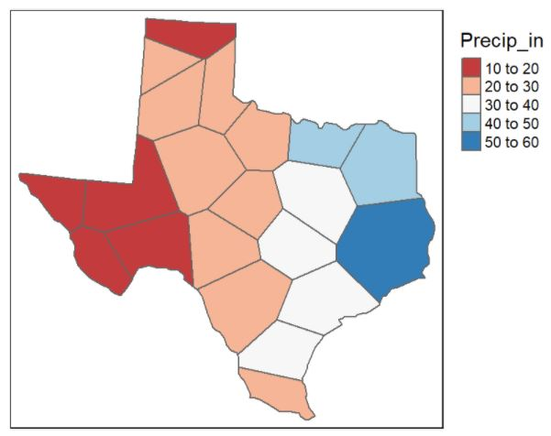
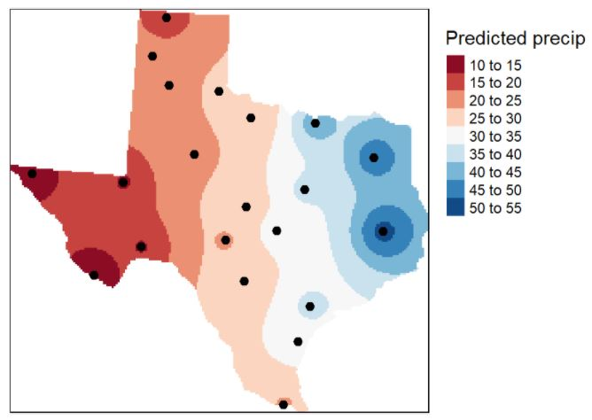
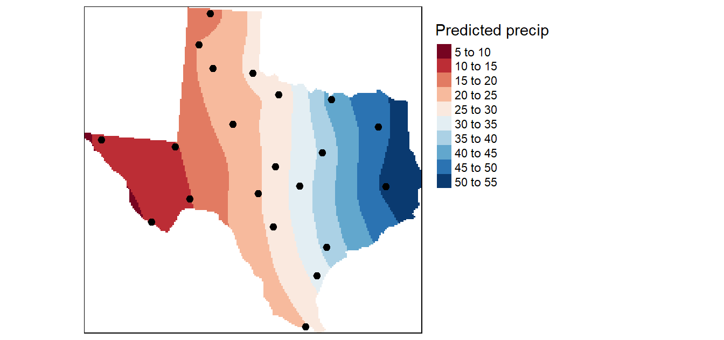
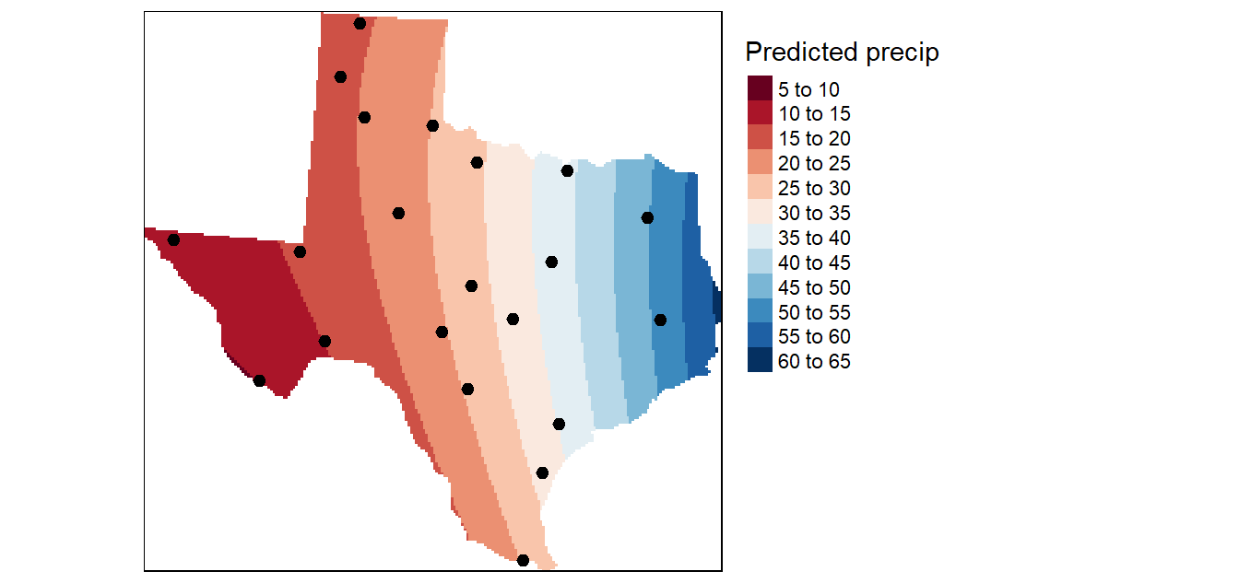
Interpolation methods
There are several spatial interpolation techniques, including:
Proximity polygons (nearest neighbor);
Inverse distance weighted (IDW);
Kriging;
Trend surfaces;
Etc.
Notes:
We can use spatial relatedness to generate gridded datasets, or surfaces, that estimate our variable of interest in areas between observed points. There are several techniques used to complete this interpolation.
Proximity polygons: which assign all unsampled locations the value of the closest sampled location; this creates a tessellated surface, where lines split the midpoint between each sampled location, forming an area around each point. The area inherits the sampled points’ value. ISSUES: Surface values change abruptly, which isn’t typical in nature.
Inverse distance weighting (IDW): this approach assumes that things that are closer together are more similar than those that are farther apart; IDW measures values at unmeasured locations by prescribing each measured point an influence on the unmeasured values that decrease as distance increases.
Kriging: a generalized linear regression technique where the value at an unsampled location is estimated from values at neighboring locations
Trend surfaces: a statistical interpolation method; we can think of this modeling as a regression on spatial coordinates
We’ll focus only on IDW and Kriging, here.

Slide 9
Inverse Distance Weighting (IDW)
IDW assumes that things that are close to one another are more alike than those that are farther apart; sound familiar?
To make predictions, IDW gives greater weights to points closest to the prediction location, and the weights diminish as a function of distance; unknown points are predicted using the weighted average of all available known points in its neighborhood.
Notes:
**in other words, the further a measured point is from the unmeasured point of interest, the less influence it will have on the prediction at the unmeasured location.

Slide 10
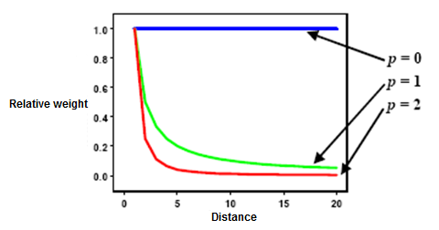
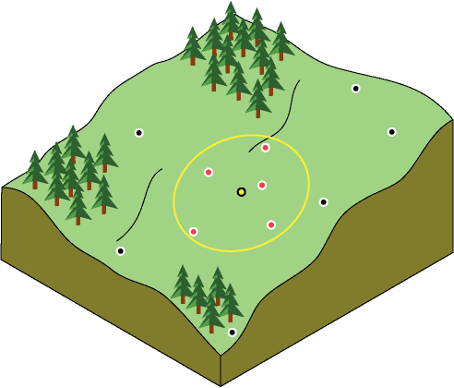
Inverse Distance Weighting (IDW)
There are two user-defined parameters in IDW:
1) p, or power: increasing p reduces the influence of more distant neighbors relative to closer ones (default in R, p = 2).; and,
2) n, or neighbors: defines the search neighborhood, the higher the n, the more values that contribute to the interpolation.
n = 5
Notes:
**in other words, the further a measured point is from the unmeasured point of interest, the less influence it will have on the prediction at the unmeasured location. If p is very high, only the immediate surrounding points will influence the prediction, if p = 0, all points have the same influence!
**we use n to exclude more distant points that will have little influence on the prediction.

Slide 11
This measured point will have far less influence on our red unmeasured point than…..
n = 7, p = 2
…this measured point due to our choice of a higher p.

Slide 12
Kriging
Where IDW interpolates uniformly across our region of interest based on p and n, kriging allows localized patterns of points to drive the interpolation process!
To make predictions, we calculate a sample variogram visualizing the spatial relatedness of points as a function of lag (or the different between the locations of two measurements) and then choose a model variogram that fits the sample for interpolation.

Slide 13
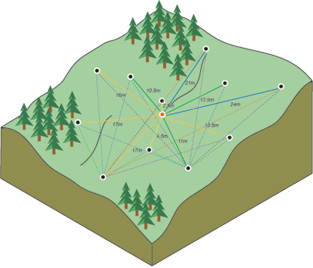
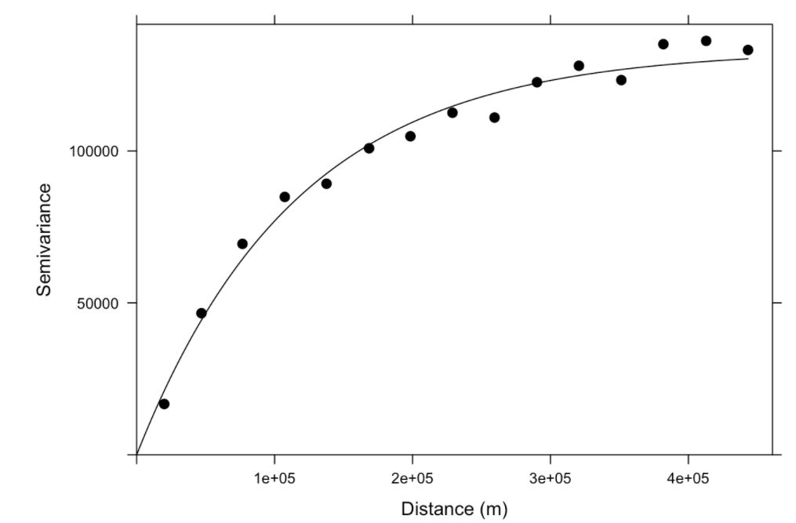
Kriging
The variogram() function in gstat computes the sample variogram by plotting all possible squared differences of observation pairs against their separation distance.
R then spits out our sample or empirical semivariogram, which we will fit a model (e.g., circular, spherical, exponential, gaussian, linear) to use for prediction.
Pairing one point (in red) with all other measured locations.
Line is Matern model semivariogram
Points are sample semivariogram
Notes:
AGAIN, things that are closer are more alike than things farther apart.
Thus, pairs of locations that are closer (far left on the x-axis) should have more similar values (low on the y-axis).
As pairs of locations become farther apart (moving to the right on the x-axis), they should become more dissimilar and have a higher squared difference (moving up on the y-axis).

Slide 14
Questions?

Slide 15
Coming up
Assignment 14 (extra credit, due Sun April 18th)
Week 15: Project Part 3
- Apply one spatial analysis tool we explored in class (e.g., spatial autocorrelation) to your data.;
- Present your data visualization and analysis clearly explaining your findings.

Slide 16
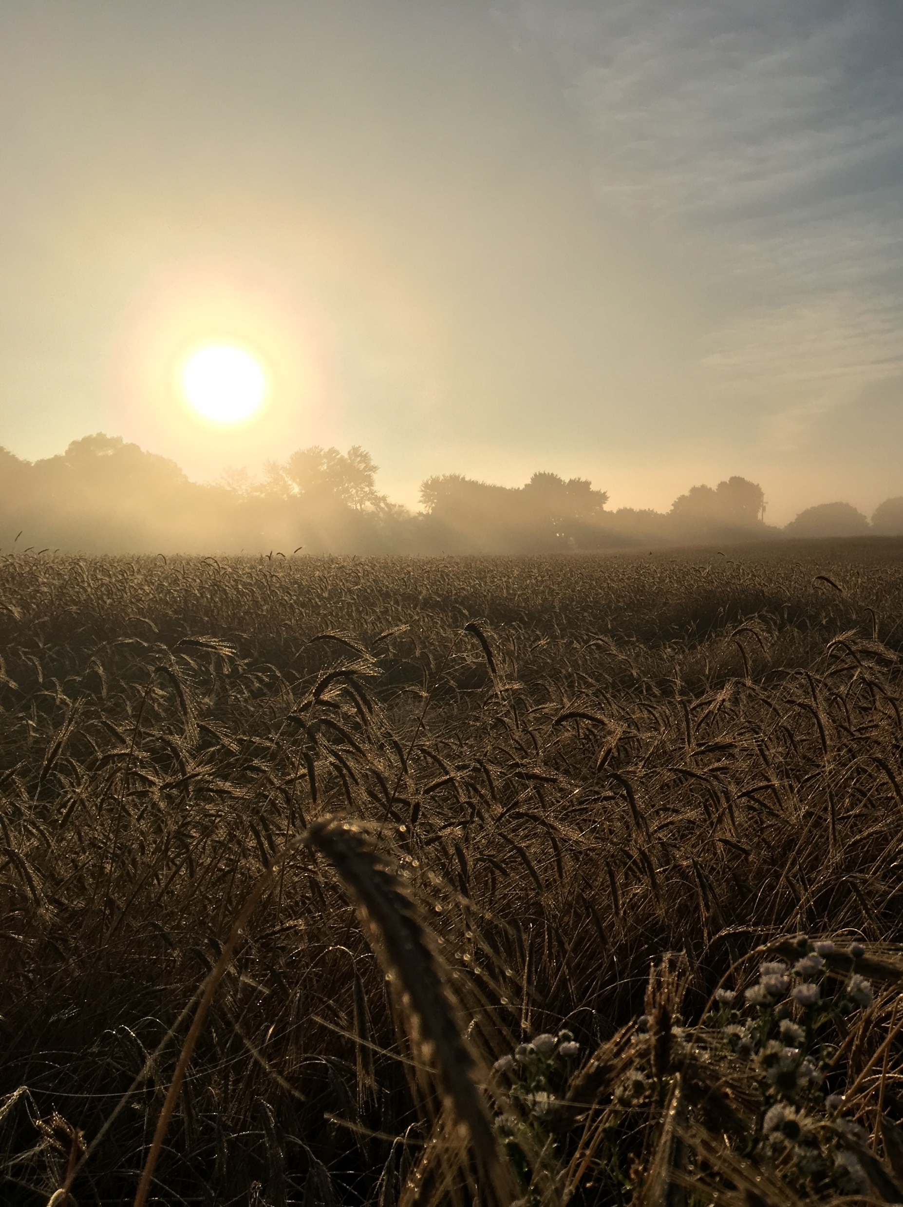
How do I use R & R spatial applications?
BY: Britta L. Schumacher

Slide 17
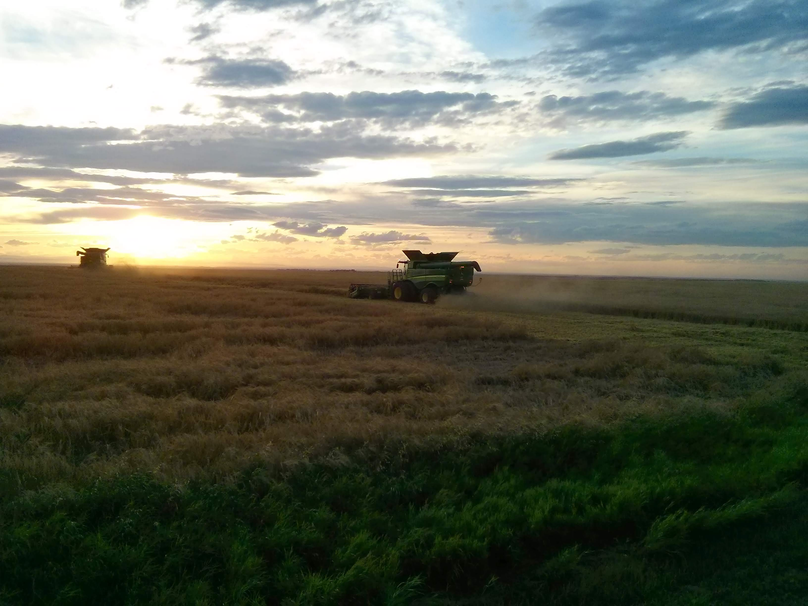
Photo: Jonno Holt
Notes:
I study spatiotemporal trends in US agriculture.

Slide 18
What do I do?
Really messy, but really cool dataset
Really messy, but really cool dataset
I take really nasty, but really interesting publicly available datasets about farmers, ….
+
raw USDA, USDC, USDL, etc. data

Slide 19

What do I do?
Really cool dataset
Really cool dataset
… tidy them up, ….
+
raw (but CLEAN/tidy) USDA, USDC, USDL, etc. data

Slide 20








What do I do?
… & pair them with really cool datasets that describe the environment in which farmers farm.
Really cool dataset
Really cool dataset
+
raw (but CLEAN/tidy) USDA, USDC, USDL, etc. data
+
+
+
+
+
+
climate &
seasonal weather
soil
irrigation
agricultural diversity
topography &
land use
time
space

Slide 21
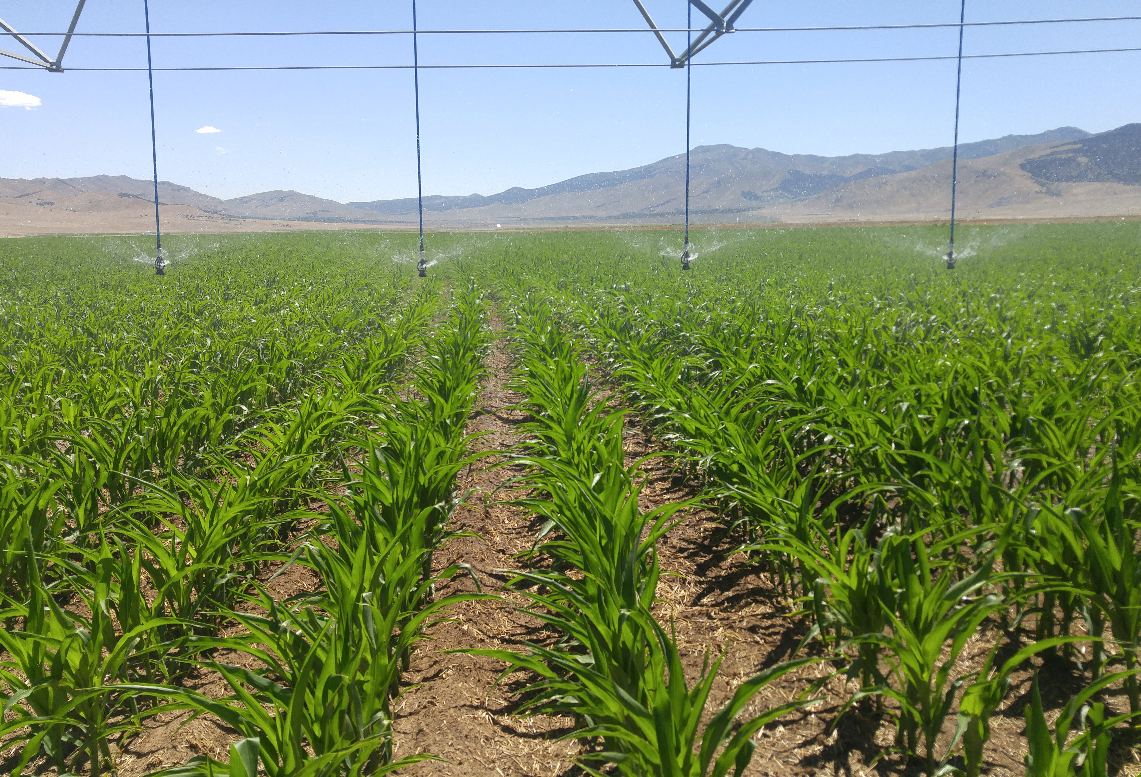
I do this to answer questions like…
What are the trends in irrigation practices, efficiencies, and yield across the West?
Where are regions that defy our expectations for crop yields (e.g., bright spots), and what are the actionable factors that predict their membership?
What are the features most important for corn yield prediction and how can their interactions with yield inform future research efforts and farmer outreach?
Who are our farmers? & how are they doing?
Photo: Jonno Holt

Slide 22









Who cares? Well, frankly, we all should…
externalities
externalities
“high-intensity” paradigm
pollinator loss
biodiversity loss
irrigation
insecticide
insecticide
irrigation
insecticide
corn
soybean
wheat
insecticide
soil chemical &
biological degradation
contamination
herbicide
irrigation
irrigation
herbicide
Decreased livelihood stability for farmers
N-P-K
N-P-K
N-P-K
climate change
N-P-K
N-P-K
N-P-K
N-P-K
resulted in consistent 20th century yield growth

Slide 23
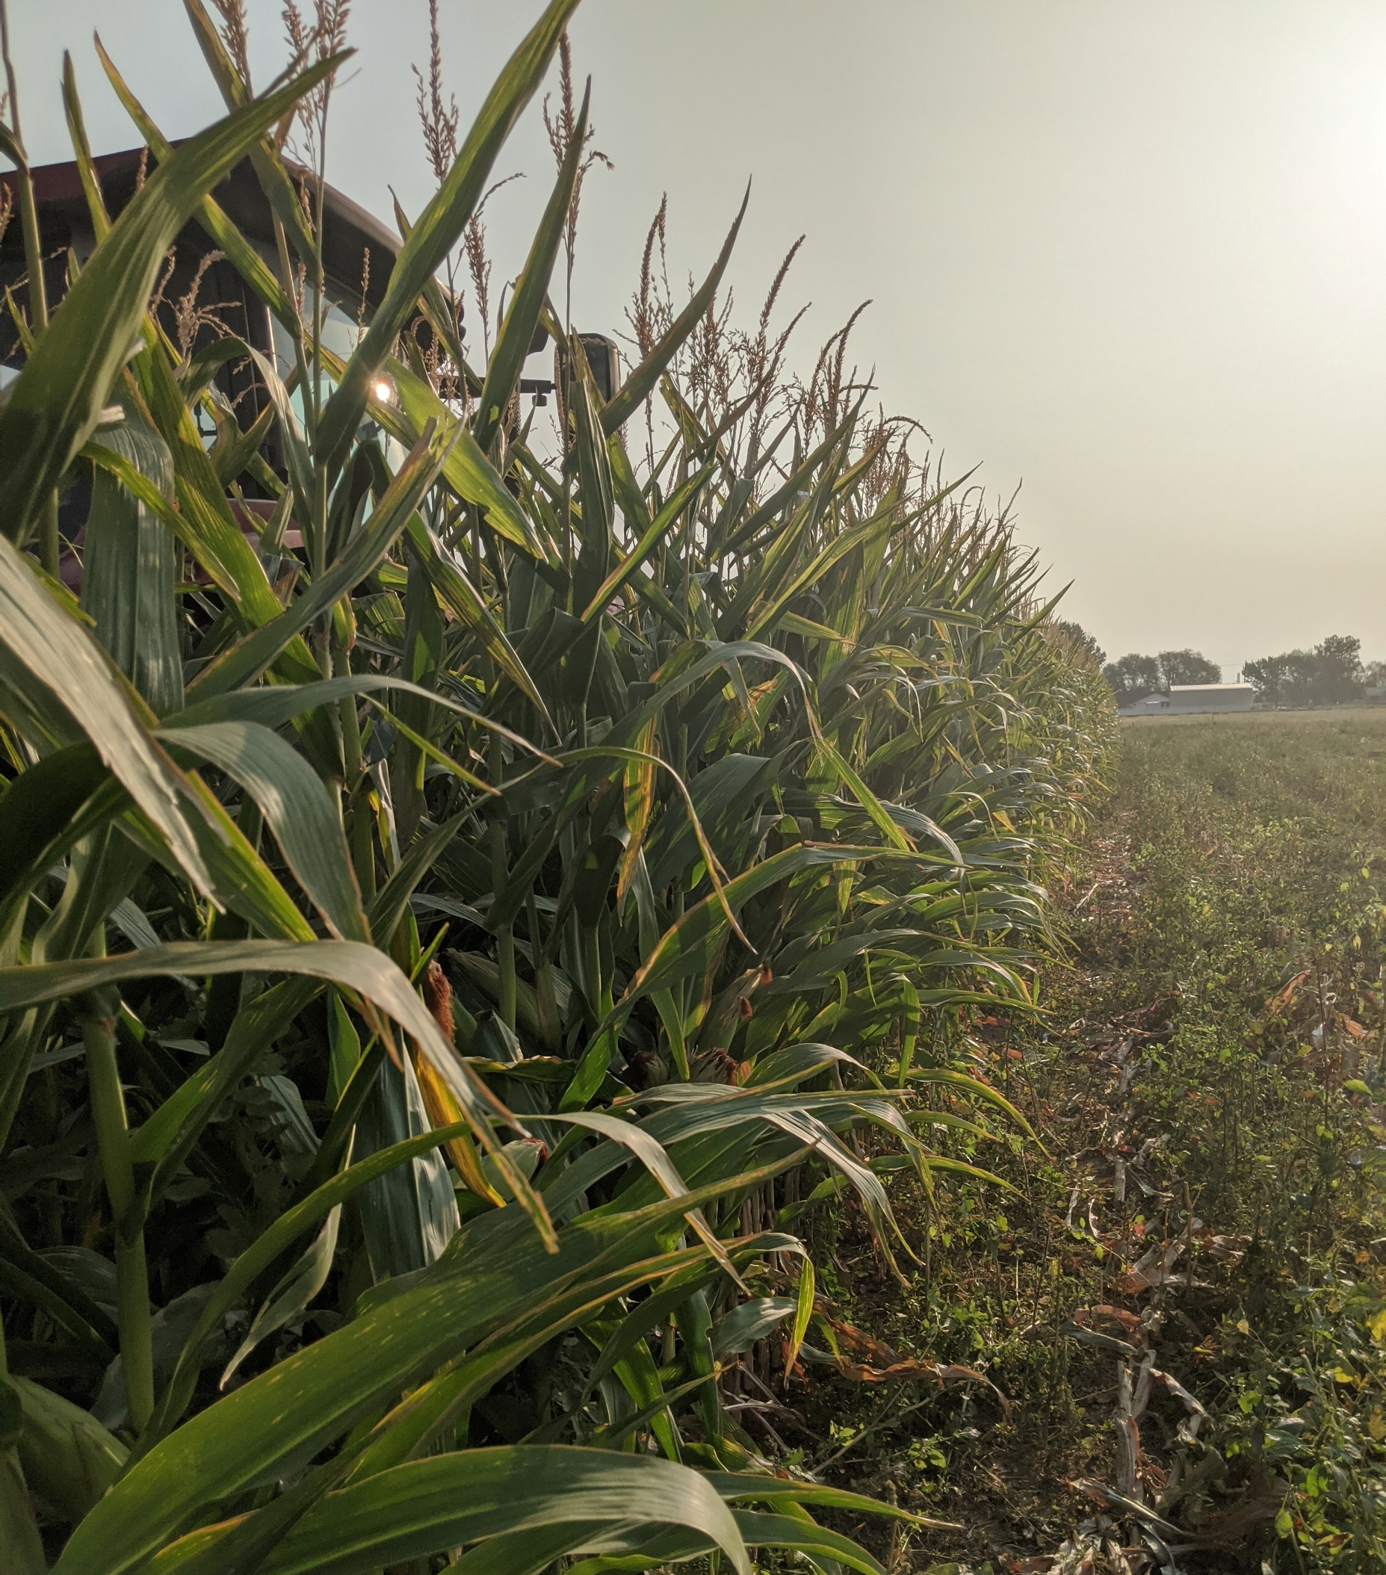
How do I answer these questions?
I take the “clean”/tidy datasets I build, and:
Explore the data through narrative approaches;
Create models (e.g., RF, LR, etc.);
Explore ensembles of models to see where they agree and disagree;
“all models are wrong, but some are useful”.
Photo: Tina Sullivan

Slide 24
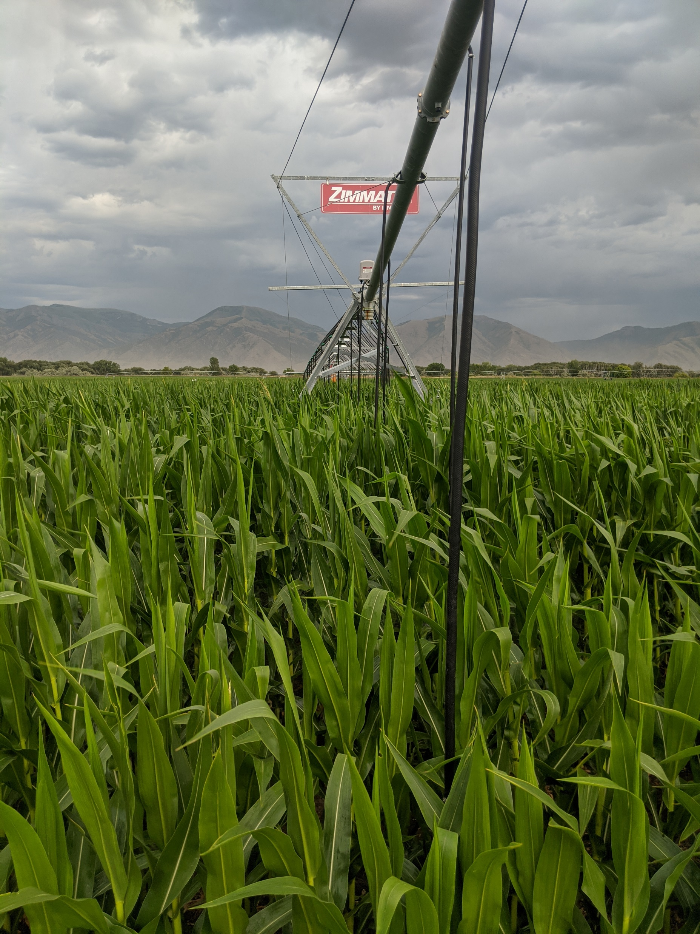
Interesting findings
1) Time & space MATTER (this is a “duh” finding, but its consistent across all the research we are doing);
2) Irrigation is the key determinant of productivity in much of the US—this is troubling cause overdraft, etc.;
3) Features (climate, soil, etc.) interact nonlinearly with yield (which means we CAN’T justify linear methods when analyzing agricultural yields);
4) Data is messy but DANG can we do cool things with it once its wrangled and clean.
Photo: Tina Sullivan
Notes:
We know that agricultural productivity and the natural suitability of land for different agricultural uses is in great part determined by soil suitability and local topography; research suggests that soil properties (e.g., cation exchange capacity, organic matter content) explain approximately 30%, and soil topography
We suspect that the disconnect between our ecological knowledge of soil importance to agricultural yield and what we see resulting from our RFs, is possibly the coarse measurement of HWSD 1-kilometer gridded data to average county-level data.

Slide 25
Unanswered questions
How can we scale-up farm-level/field-level data to think about US agriculture nationally?;
Who are the people who pick and process our food and how are they doing?;
How do farmers make decisions regarding on-farm management?; what are the constraints and opportunities for adopting different practices? How has their experience as a farmer, and in agriculture industry changed over their lifetimes?
Where is US agriculture heading (from farmer’s perspectives)?
Notes:
PLUS, We see a different trend reflected in our partial dependence plots of SDI on yield, where yield remains constant until SDI reaches about 0.8, at which point yield steadily decreases until leveling off at SDI of about 1.5.

Slide 26
Questions?

Slide 27
REMINDER: Coming up
Assignment 14 (extra credit, due Sun April 18th)
Week 15: Project Part 3
- Apply one spatial analysis tool we explored in class (e.g., spatial autocorrelation) to your data.;
- Present your data visualization and analysis clearly explaining your findings.

